Slide 1
Liberalization and competition on the energy market in Czech Republic and Austria
How are the last price trends in Czech Republic and in Austria?
Mader Georg (Karl- Franzens Universität Graz)
Matoušová Hana (University of Economics, Prague)

Slide 2
Background Information:
The situation before liberalization
The reasons for market liberalization
The way to a liberalized market

Slide 3
The way to a liberalized market
Electricity Market:
December 1996: Directive 96/92/EC: target of purposing a single electricity market
First step: customers with > 40 GWh cons.got access to the liberalized market.
Three years later >20 GWh
three years later to >9 GWh.

Slide 4
Austria:
1998: Austria included this directive in the Elektrizitaetswirtschafts- und –organisationsgesetz („EIWOG 1998”) (Electricity Industry and Electricity Organisation law)
1st October 2001: Total liberalization

Slide 5
Gas Market:
Directive 98/30/EG: ensured transparency of prices and the transit of gas
incorporated to the national law of the member states until 10th of August 2000

Slide 6
AUSTRIA:
Regulated by electricity law 1938 which has been amended in 1948 for gas supply
complete gas law has been regulated by the “Gaswirtschaftsgesetz 2000”, called GWG (in English gas economy law
Directive 98/30/EG was included in Austria in 2000
double-stage market liberalization until October 2002
First step: >25m³ gas per year

Slide 7
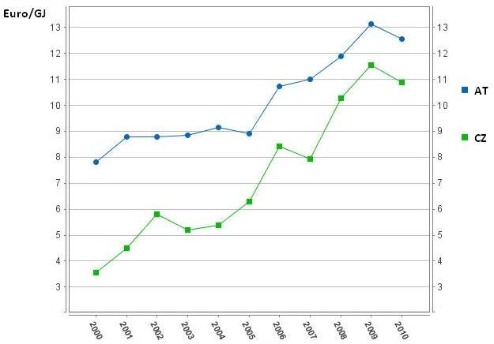
Gas market since the liberalization:
AT x CZ:

Slide 8
Gas market since the liberalization:
CZ: Supplier changes in gas sector in 2005 – 2011
  till 05/2011 7,8 % consumers
  01/10 - 05/11 count of suppliers 8 -> 25
Year | 2005 | 2006 | 2007 | 2008 | 2009 | 2010 | 2011 (till the end of May)
# | 2 | 454 | 6699 | 596 | 33327 | 84424 | 100324
Source: www.ote-cr.cz

Slide 9
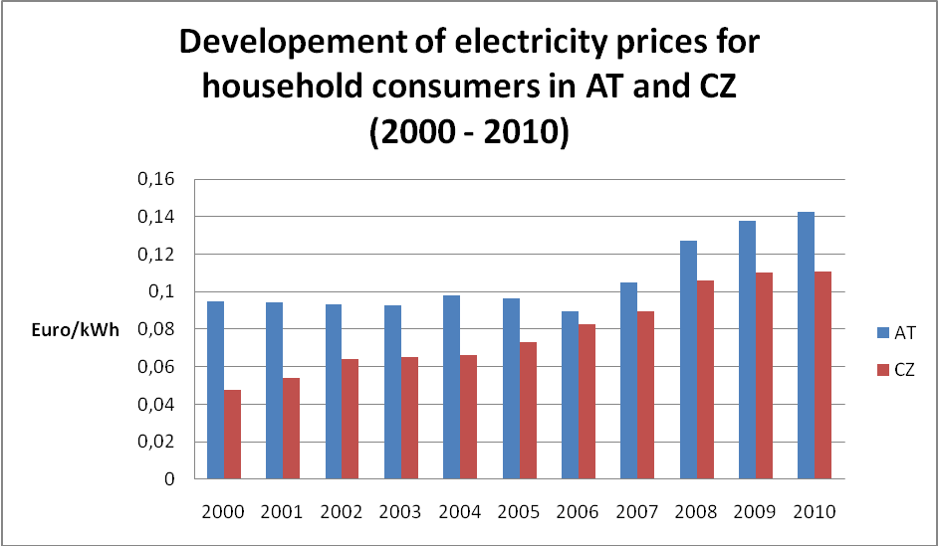
Electricity Market since the liberalization:

Slide 10
Electricity Market since the liberalization:
CZ: Supplier changes in electricity sector in 05 –11
  till 05/2011 700 000 changes
Year | 2003 | 2004 | 2005 | 2006 | 2007 | 2008 | 2009 | 2010 | 2011 (till the end of May)
# | 16 | 399 | 3 511 | 13 150 | 46 016 | 57 689 | 96 744 | 249 181 | 204 142
Source: www.ote-cr.cz

Slide 11
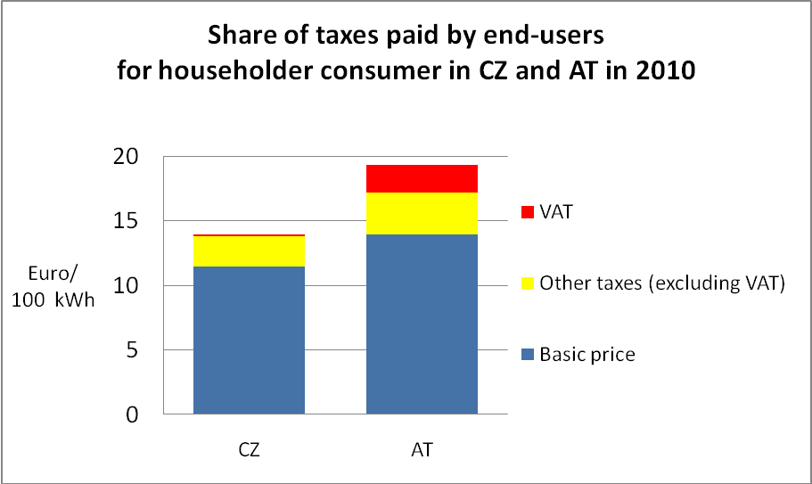
The composition of the electricity price:

